Slide 1

City of Seat Pleasant
Department of Public Works

Slide 2
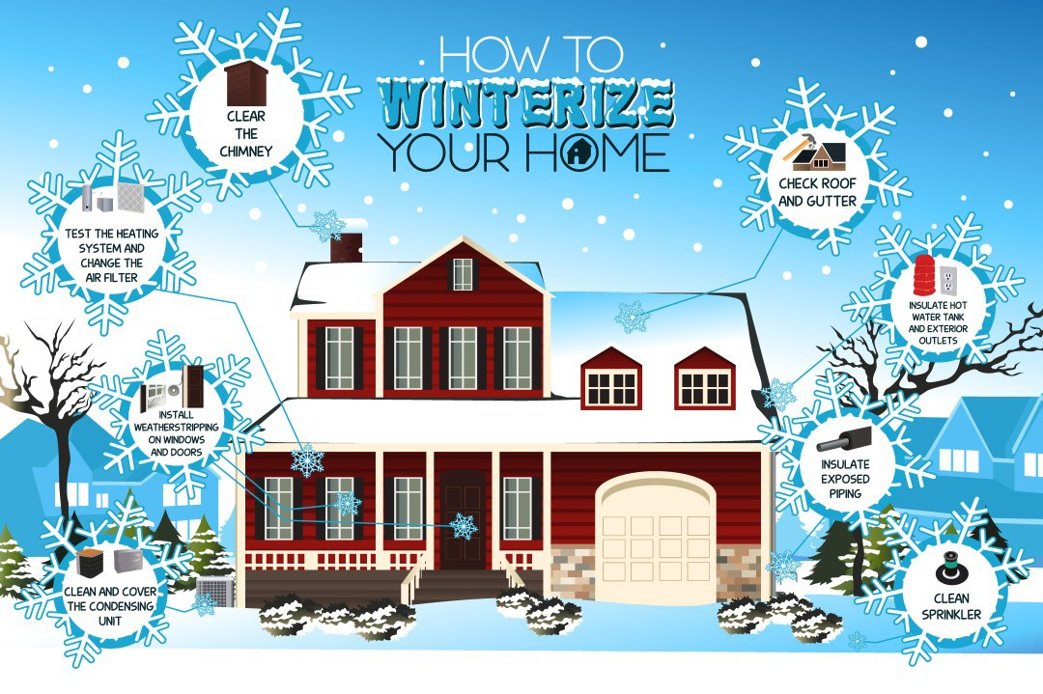
City of Seat Pleasant
Department of Public Works

Slide 3
City of Seat Pleasant
Department of Public Works
Weatherization Assistance Program
The Weatherization Assistance Program (WAP) is no longer administered by the Prince George’s County Department of Housing and Community Development. Maryland Department of Housing and Community Development
If you are interested in applying for weatherization, please call the Office of Energy Efficiency at the Maryland Department of Housing and Community Development on: 844-400-3423 or 1-800-756-0119. There is no cost to eligible county residents. Weatherization helps income eligible households lower their energy cost by an average of 30 to 35%. If you have filed an application with our office, all records and requests have been transferred to the MD Office of Energy Efficiency. You should have received a letter from us with additional information about the status of your application and the referral process.

Slide 4
City of Seat Pleasant
Department of Public Works
Weatherization Assistance Program
Qualifications Requirements
To qualify, a household must: Meet minimum requirements - call the Office of Energy Efficiency for requirements;
Prove homeownership;
Be elderly (60+) or disabled or have a family with children under 5 years old and/or have excessive energy consumption (Preference is given to elderly /disabled homeowners;
Cannot have received prior weatherization services through the Prince George's County's WAP or the MD Office of Energy Efficiency.

Slide 5
City of Seat Pleasant
Department of Public Works
Winterizing Your Home
A Guide to Winterizing Your Home
There are steps you can take to protect your home and your pipes from the cold and may reduce your energy cost for heating your residence. It's important to protect your household plumbing pipes and inside water meter from freezing or bursting.
It is a good idea to have your utilities’ telephone numbers in an easy-to-find location.
WSSC Emergency Call Center - 301-206-4002
WSSC Customer Contact Center - 301-206-4001

Slide 6
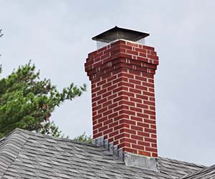
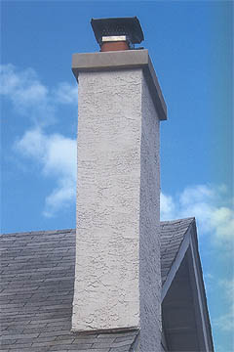
City of Seat Pleasant
Department of Public Works
Clear your Chimney

Slide 7
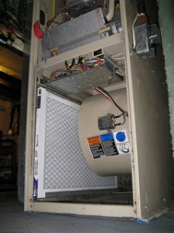
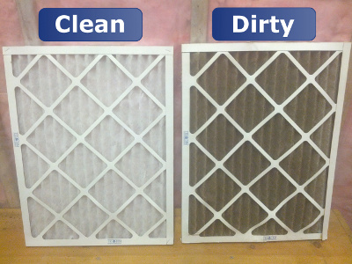
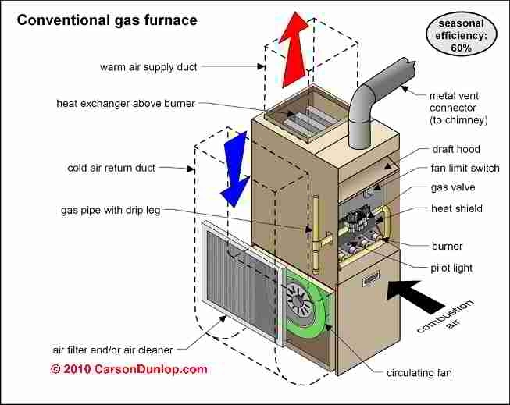
City of Seat Pleasant
Department of Public Works
Test your heating system and change the filter

Slide 8
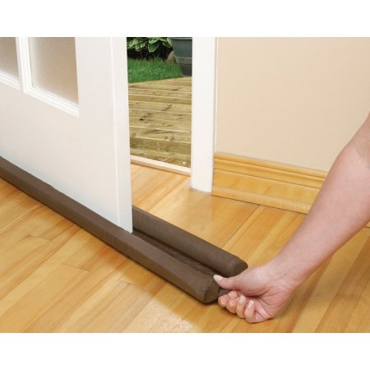
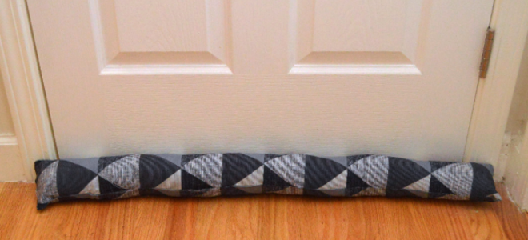
City of Seat Pleasant
Department of Public Works
Install weather strips at doors
To reduce cold air entering you home
To reduce heat from escaping you home

Slide 9
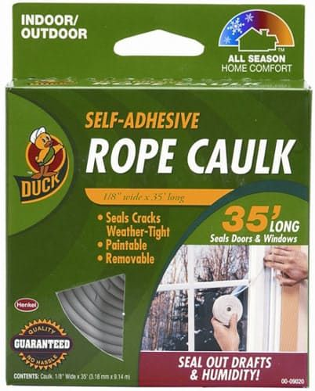
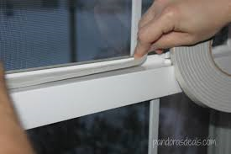
City of Seat Pleasant
Department of Public Works
Install weather strips at windows
To reduce cold air entering you home
To reduce heat from escaping you home

Slide 10
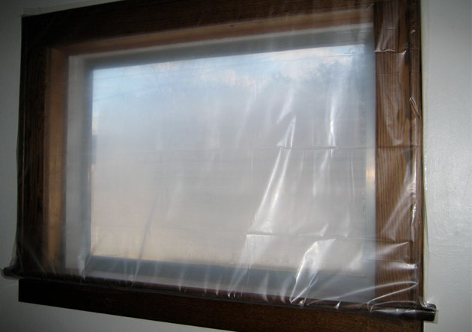
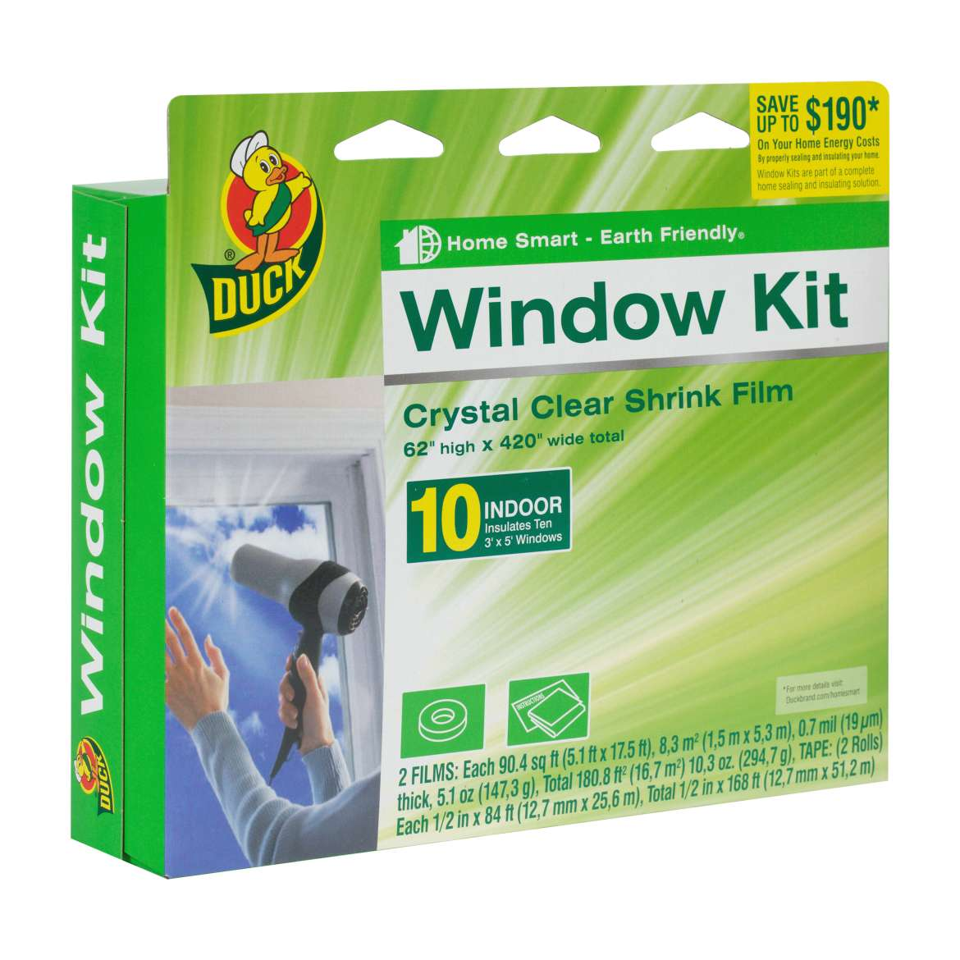
City of Seat Pleasant
Department of Public Works
Install weather strips at windows
To reduce cold air entering you home
To reduce heat from escaping you home

Slide 11
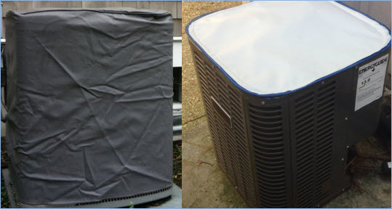
City of Seat Pleasant
Department of Public Works
Clean and cover your condenser unit/outdoor A/C unit

Slide 12
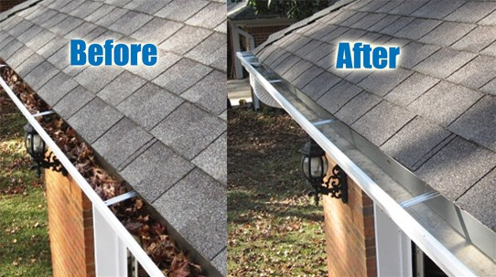
City of Seat Pleasant
Department of Public Works
Check and clear your cutters

Slide 13
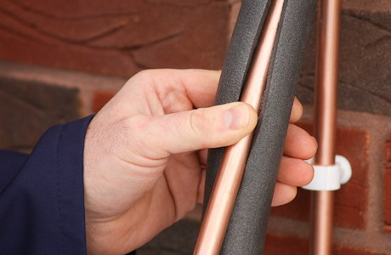
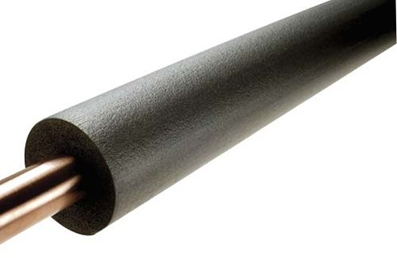
City of Seat Pleasant
Department of Public Works
Insulate exposed water pipes

Slide 14
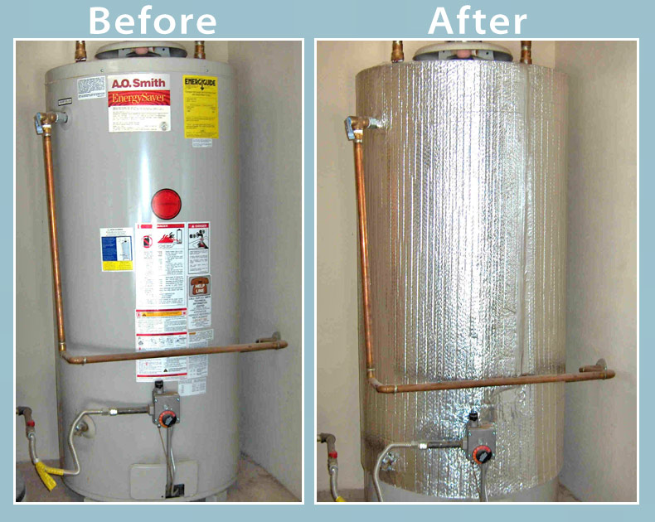
City of Seat Pleasant
Department of Public Works
Insulate your hot water heater and exterior outlets

Slide 15
City of Seat Pleasant
Department of Public Works
Space Heater Safety & Tips
Plug heaters directly into wall socket, never an extension cord
Place heaters where they cannot be tipped over
Never leave unattended
Do not use heaters to dry clothes or other items
Keep area around heater clear of clothing and combustible materials

Slide 16
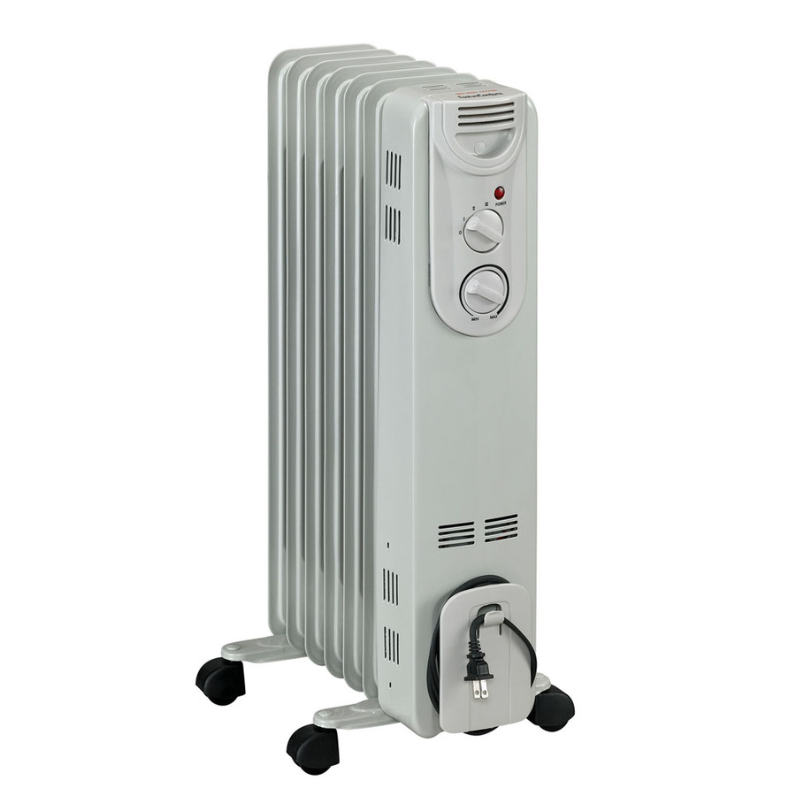
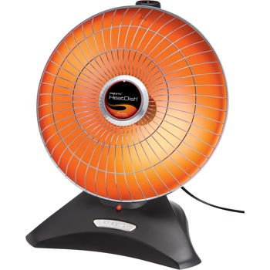
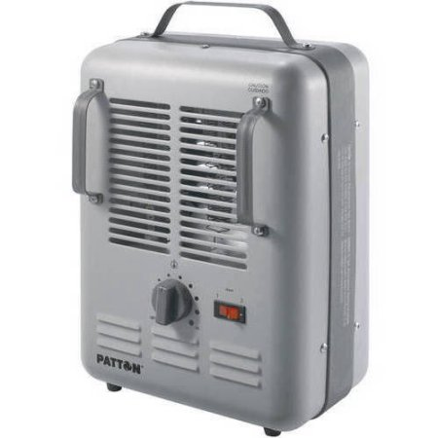
City of Seat Pleasant
Department of Public Works
Space Heater Safety & Tips

Slide 17
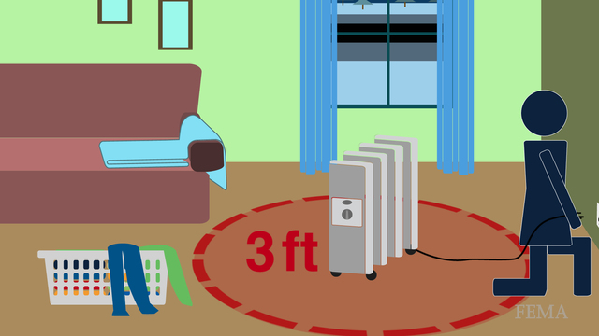
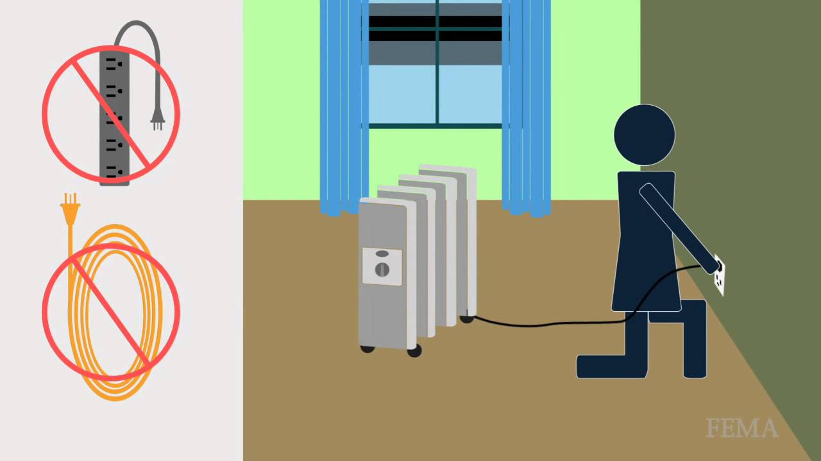
City of Seat Pleasant
Department of Public Works
Space Heater Safety & Tips

Slide 18
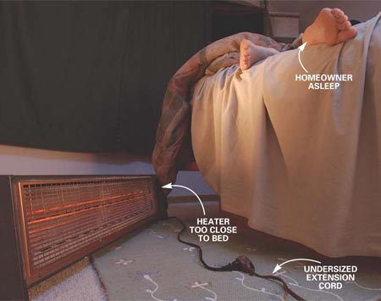
City of Seat Pleasant
Department of Public Works
Space Heater Safety & Tips

Slide 19


City of Seat Pleasant
Department of Public Works

Slide 20
City of Seat Pleasant
Department of Public Works
The state only issues salt when the first snow flake falls.
Please note: the two locations are Tuxedo Road and the New Carrollton Facilities

Slide 21
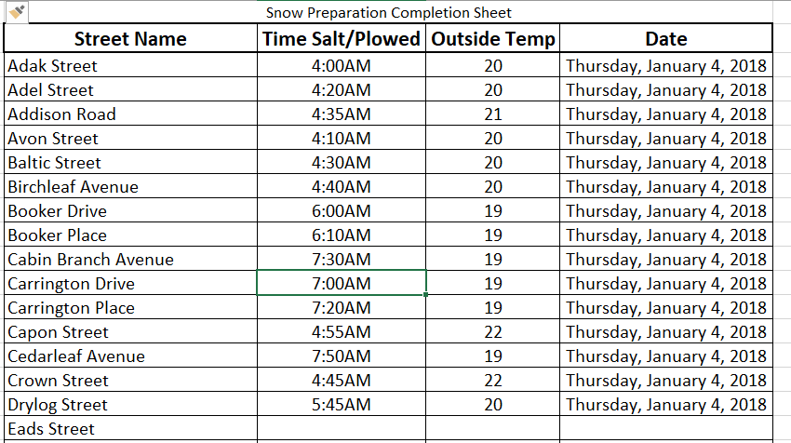
City of Seat Pleasant
Department of Public Works

Slide 22
City of Seat Pleasant
Department of Public Works
INITIAL APPLICATION OF SALT
Maintain Main Arteries
To keep essential and emergency traffic moving, main arteries must be plowed.
Continue to Plow Main Streets
During storms of 3 inches or more, snow must be kept continually plowed to ensure travel and emergency vehicle access.
Start Secondary Streets & Hills
Once snow plowing is completed, abrasives will be applied to main routes first and secondary roads on hills, curves, and intersections as required.

Slide 23
City of Seat Pleasant
Department of Public Works
INITIAL APPLICATION OF SALT
Patrol for Snow Drift and Ice
To patrol for drifting snow and ice conditions on days following a storm. Normal response is upon request of residents and police reporting these conditions.
Remove Snow in the Core of City
Work may involve plowing snow away from intersections for safety, removing the snow bank on each side of the street, and cutting snow banks for line of sight. This process can go on a few days after a storm depending on conditions.

Slide 24
City of Seat Pleasant
Department of Public Works
INITIAL APPLICATION OF SALT
CITY OWNED PROPERTIES SUCH AS CITY HALL, PUBLIC WORKS FACILITY, POLICE STATION, ENTRANCE TO PARKS, CITY LEASED PROPERTIES AND COMMON AREAS.
Snow fighting vehicles will begin with main buildings, followed by secondary buildings, then parks and common areas.
Keep in mind that you can place work orders for the Public Works Department by using the Seat Pleasant app.
Feel free to contact the
Public Works Department at 301-336-2600 ext. 2245

Slide 25
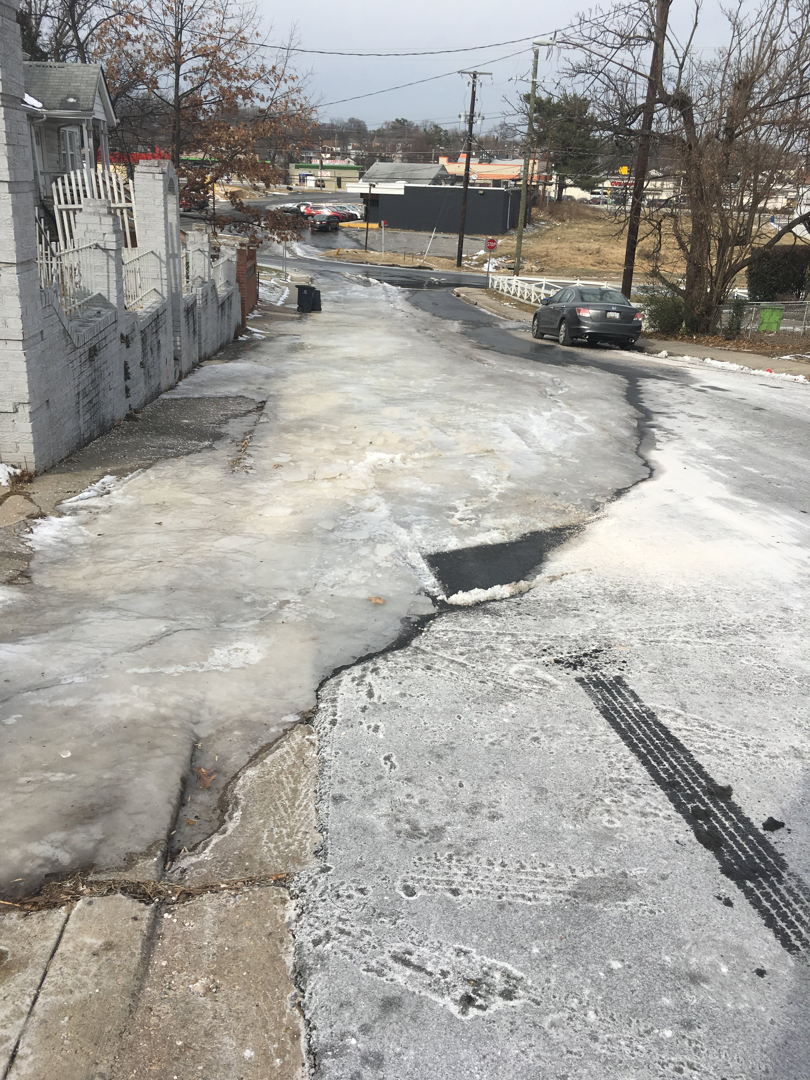
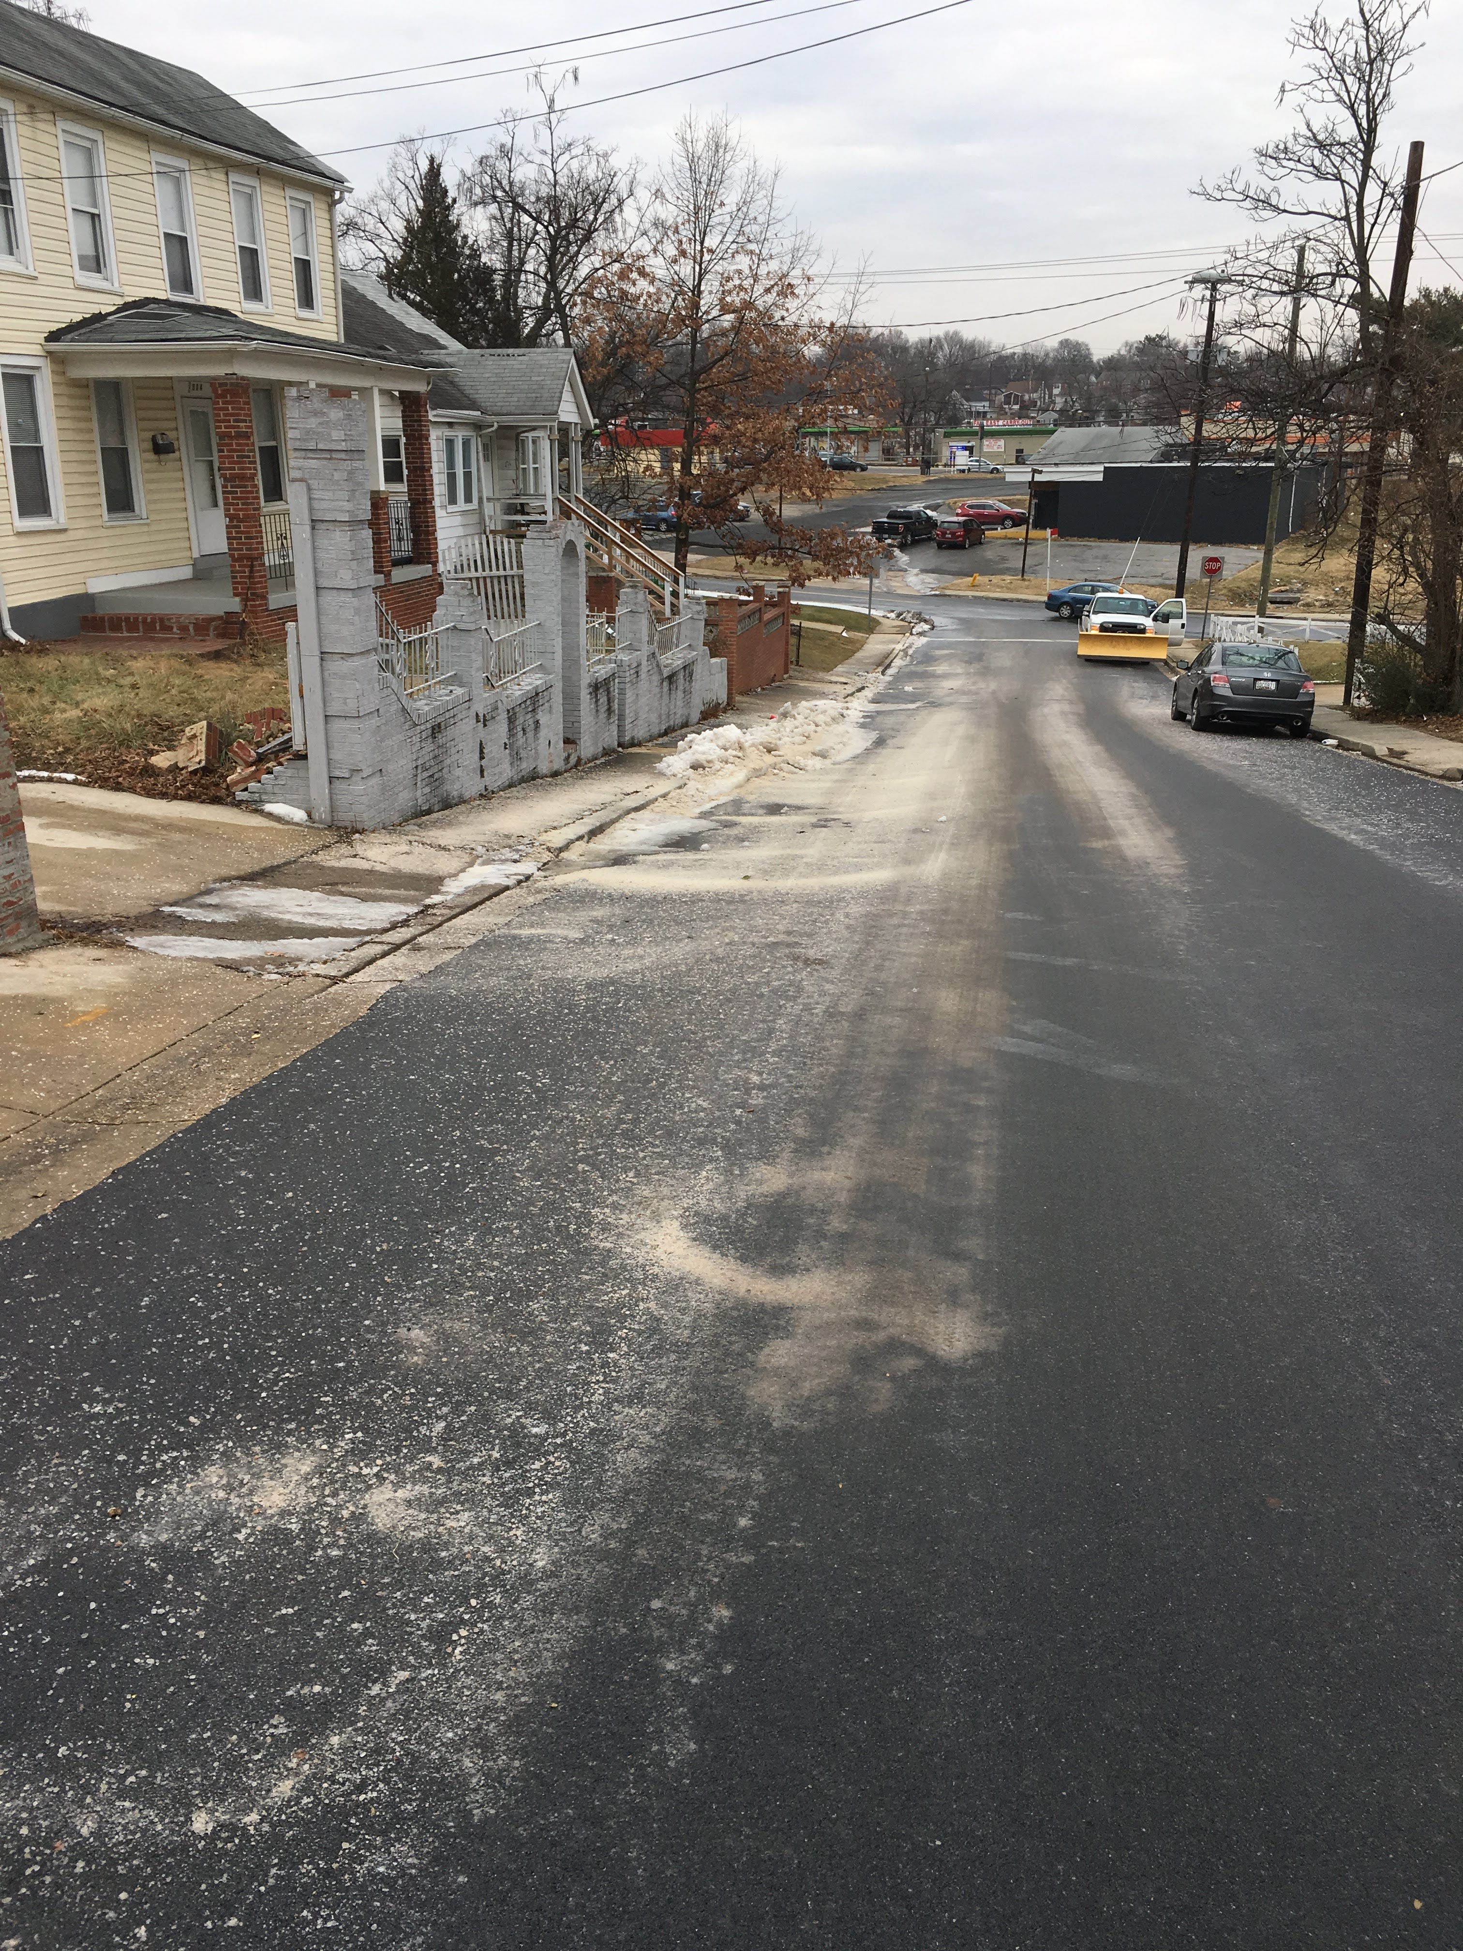
City of Seat Pleasant
Department of Public Works
Before After
69th Place

Slide 26
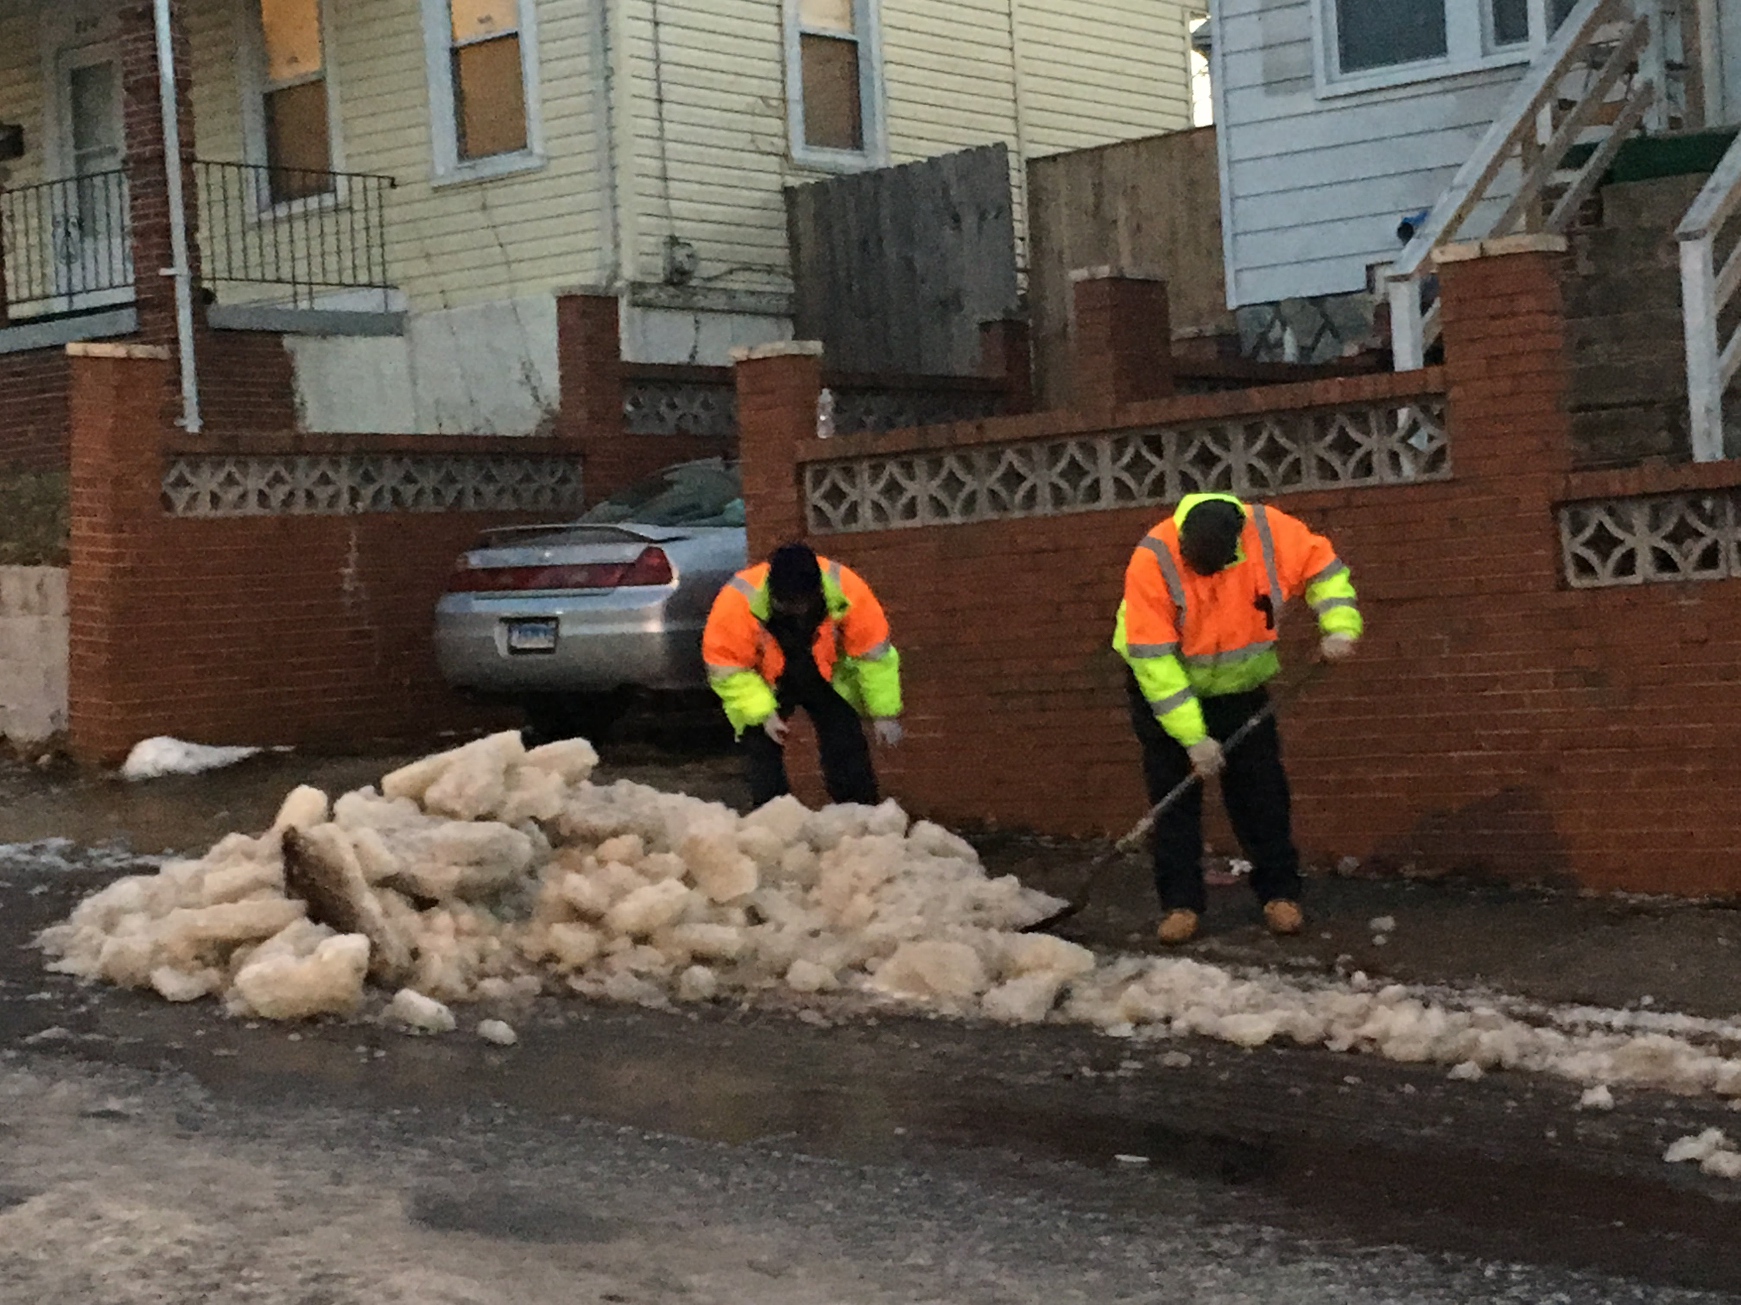
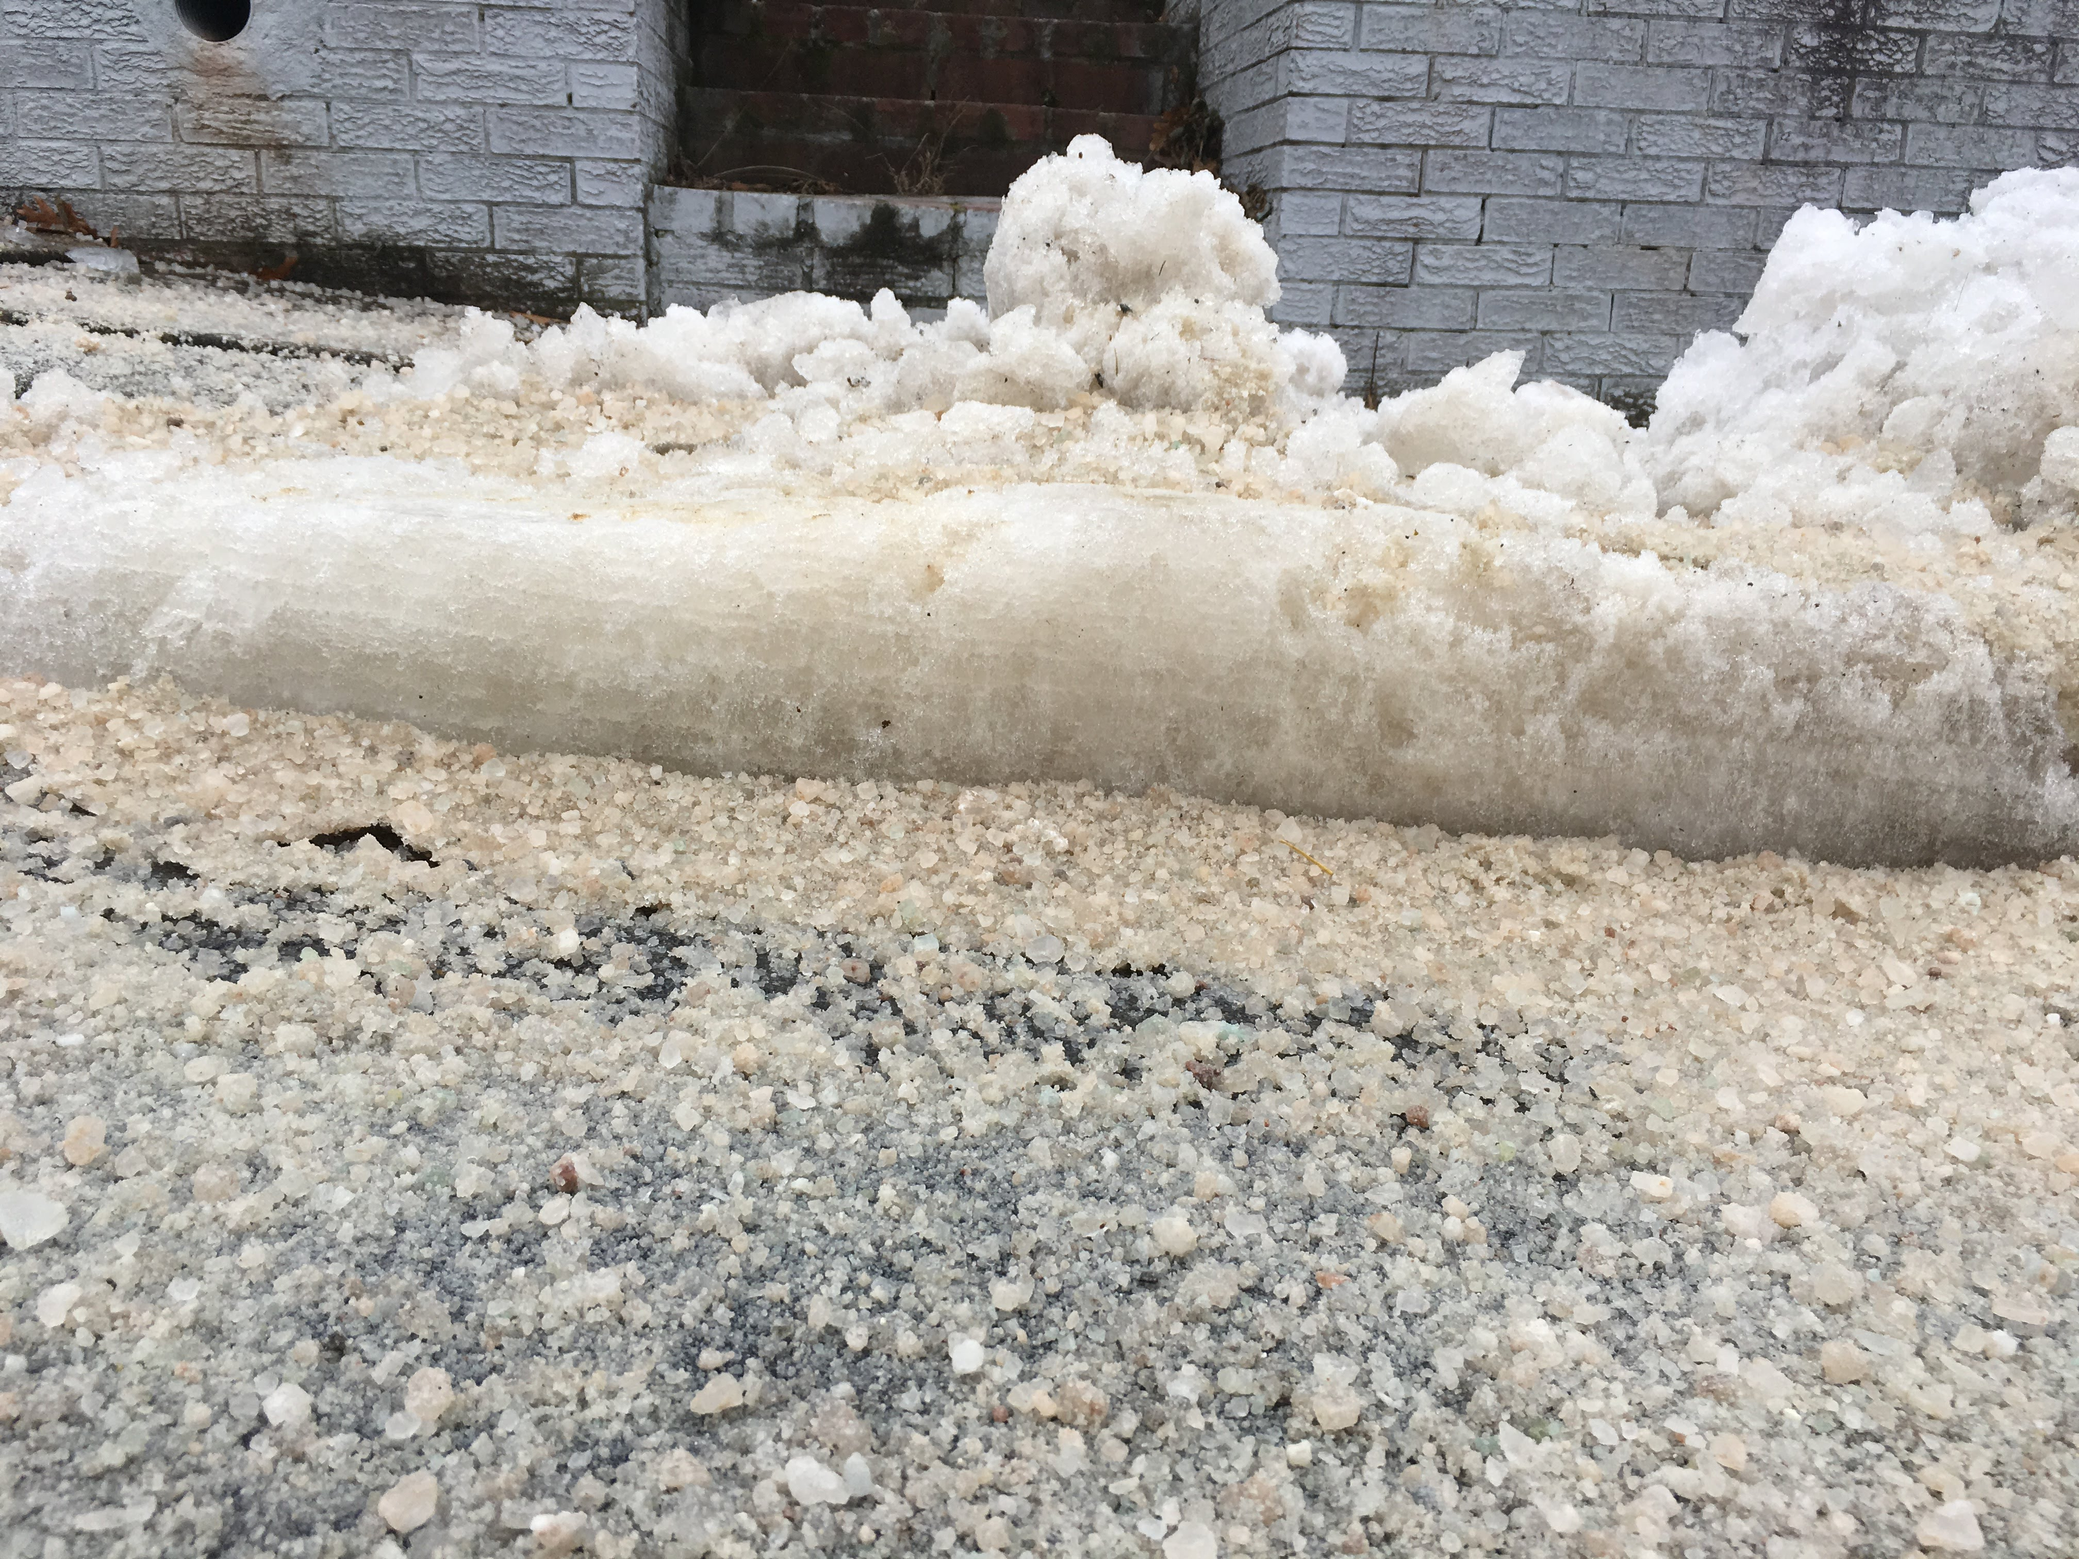
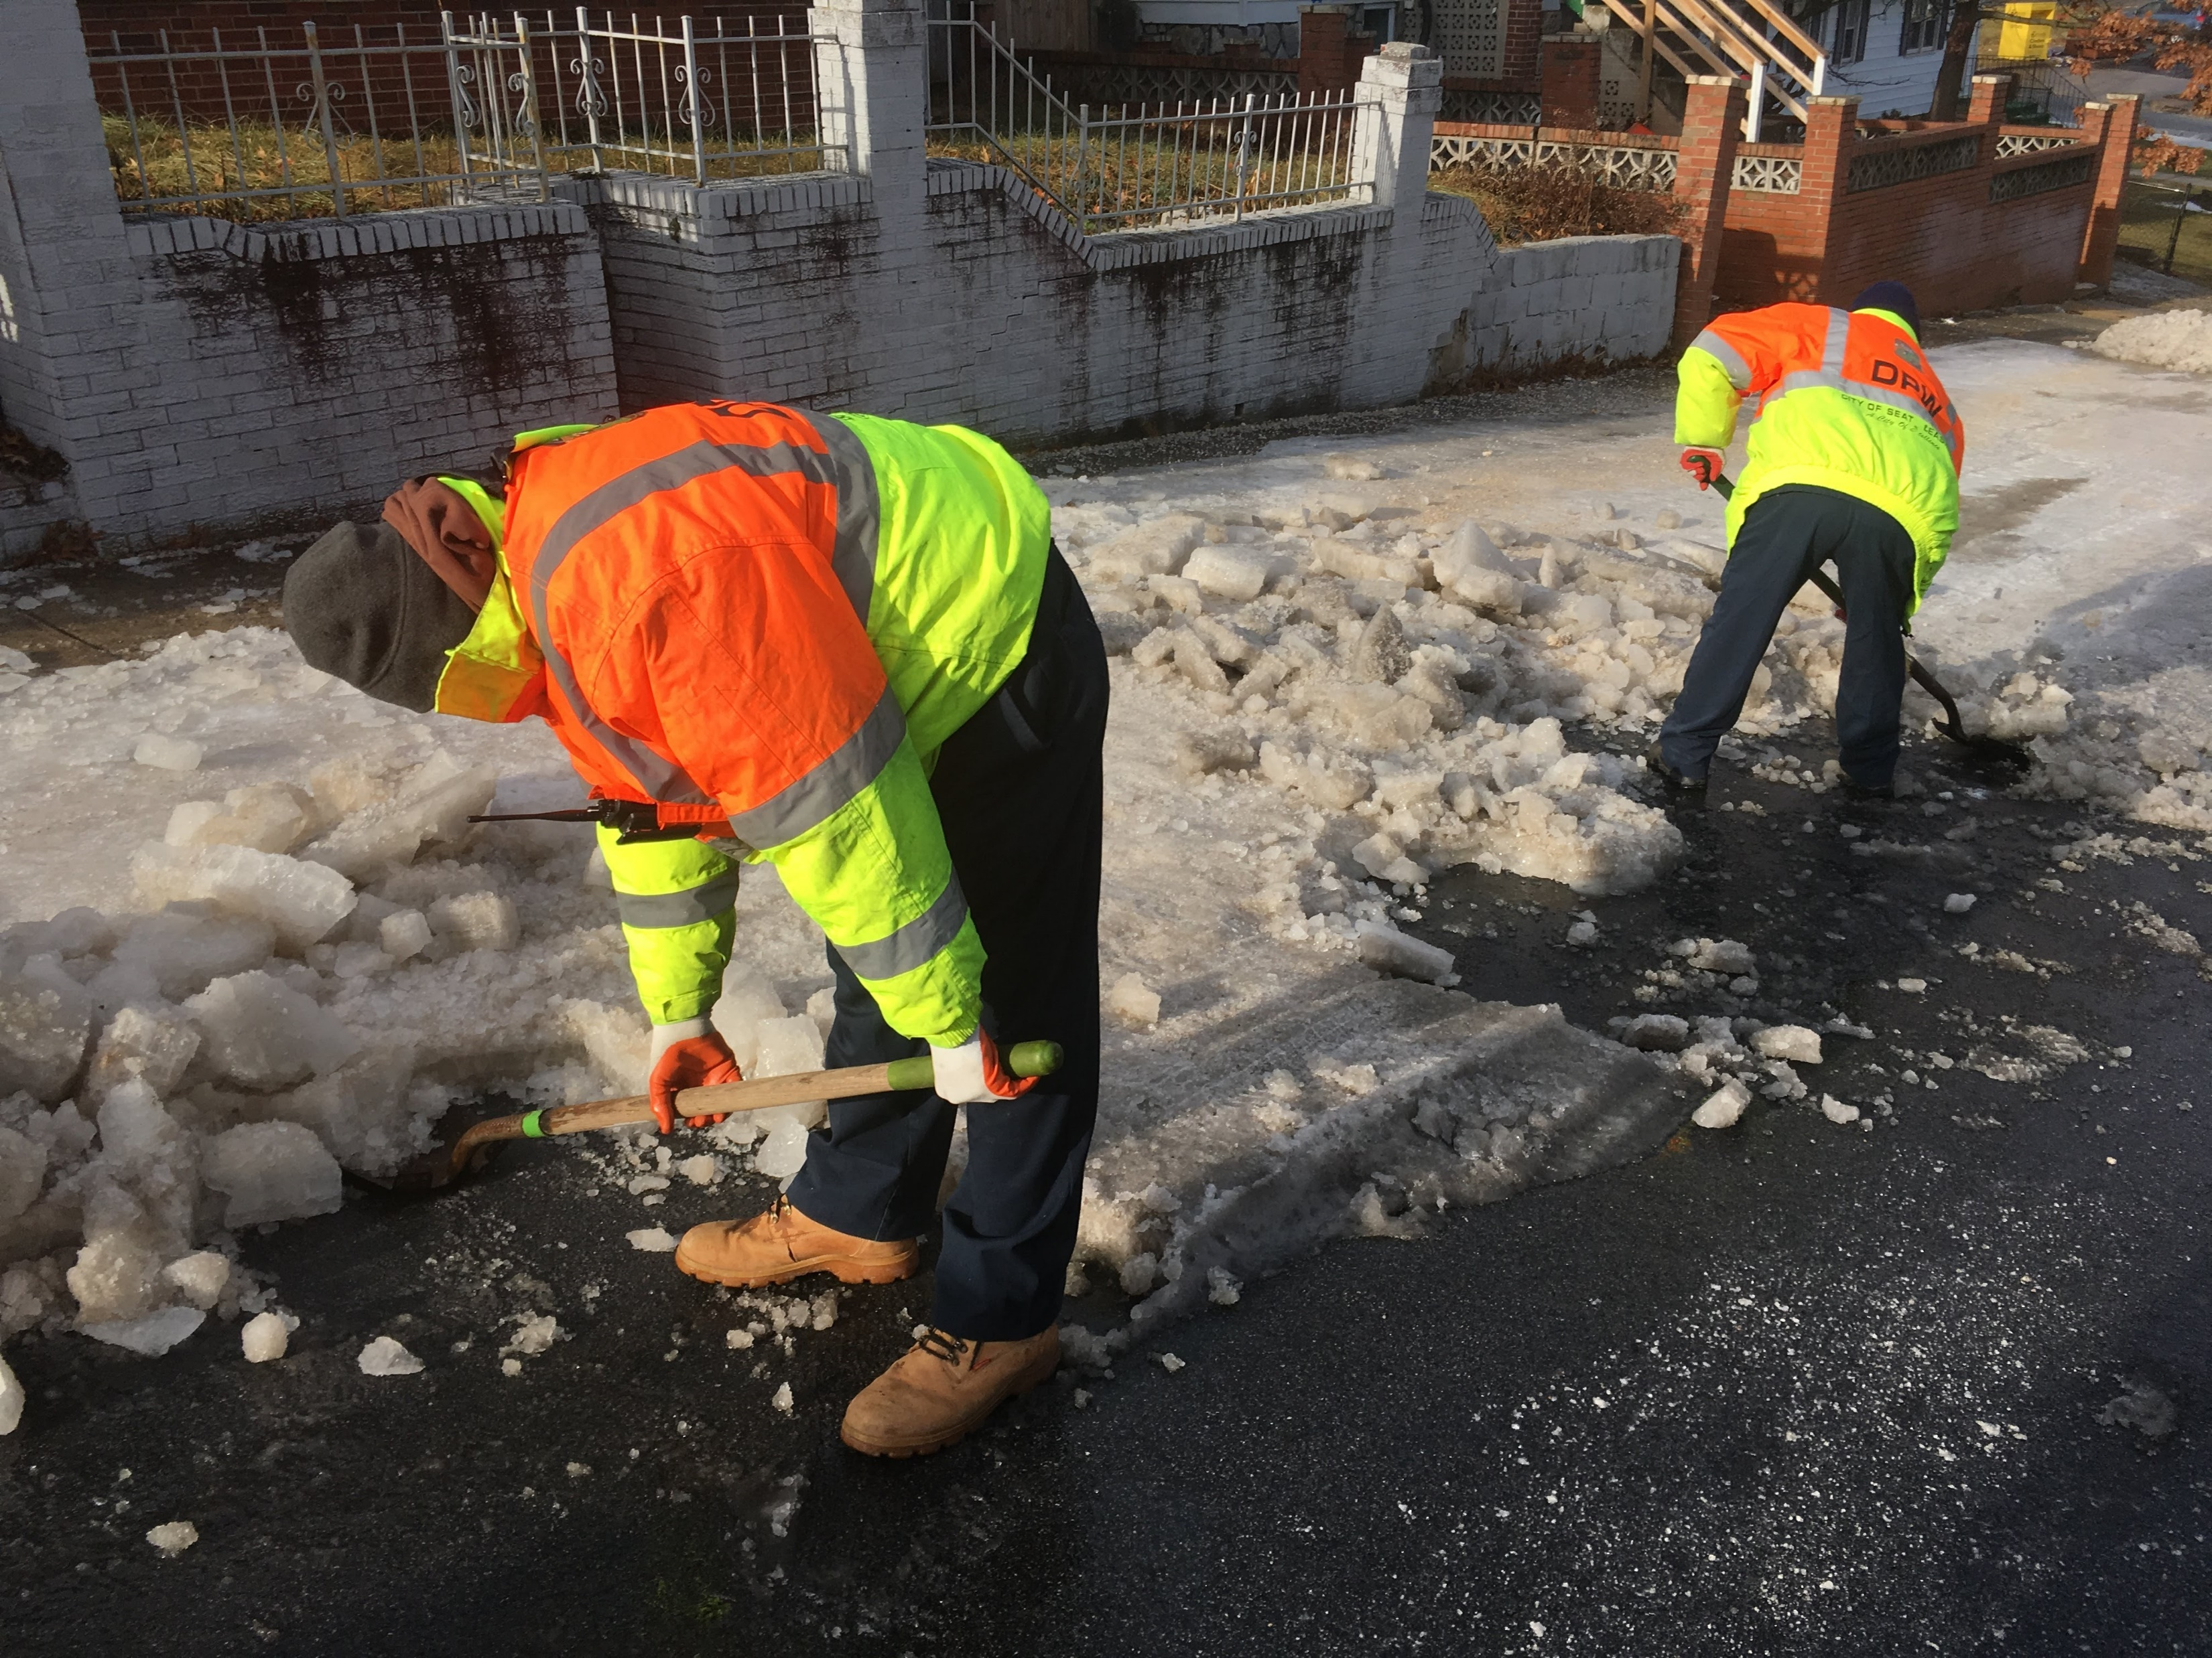
City of Seat Pleasant
Department of Public Works
DPW working on 69th Place

Slide 27
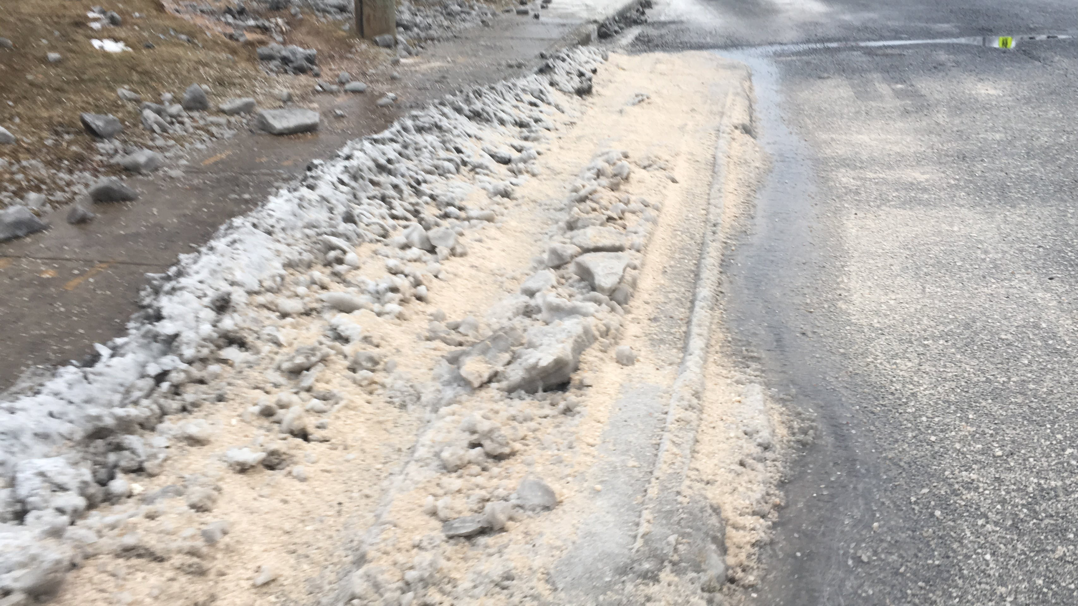
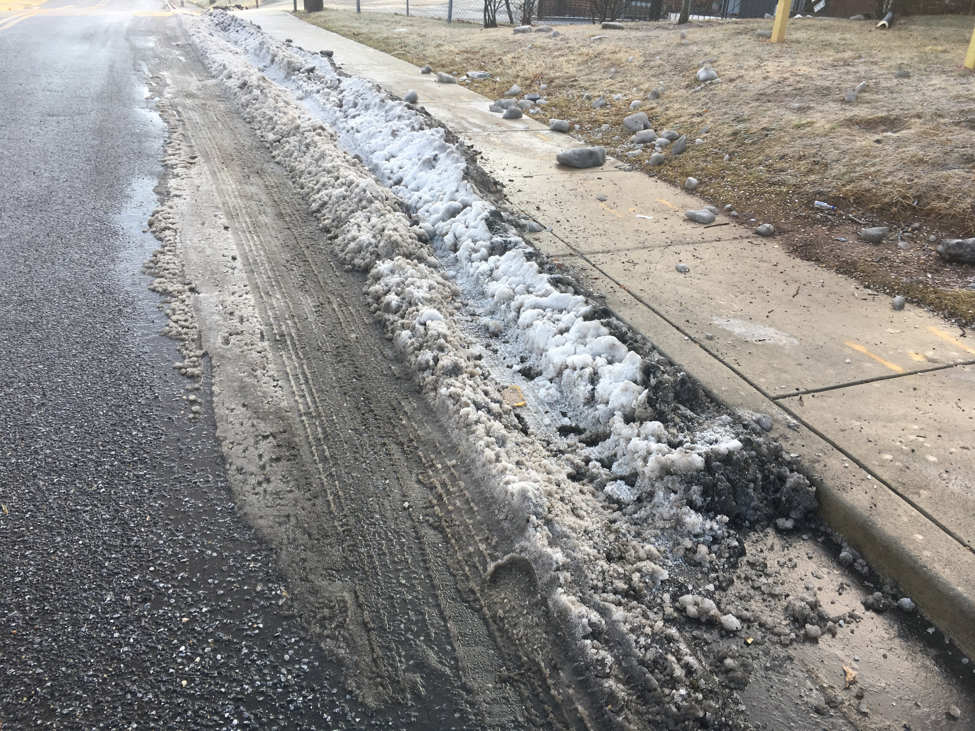
City of Seat Pleasant
Department of Public Works
Seat Pleasant Drive and Addison Rd
Before After

Slide 28

City of Seat Pleasant
Department of Public Works
https://youtu.be/2hcL3WDVH-0

Slide 29

City of Seat Pleasant
Department of Public Works

